Slide 1
Article Summary, Critique, and Extension Gozani, T., McDaniel, F. D., & Doyle, B. L. (2009). Conventional and Non-Conventional Nuclear Material Signatures. AIP Conference Proceedings, 599(1), 599-605. doi:10.1063/1.3120108
Alex Hagen
Purdue Nuclear Engineering Ph.D. Qualifying Oral Exam
2/19/13

Slide 2
Presentation Outline
Summary of Article
Pulsed Fast Neutron Analysis
Nuclear Resonance Fluorescence
Dual Energy X-Ray Radiography
High Energy Bremsstrahlung Backscattering
Critique of Article
Audience/Target
Work Presented
Extension of Article
Comparison of Techniques

Slide 3
Article Summary
Description and Sectionwise Review of Gozani’s Conventional and Non-Conventional Nuclear Material Signatures

Slide 4
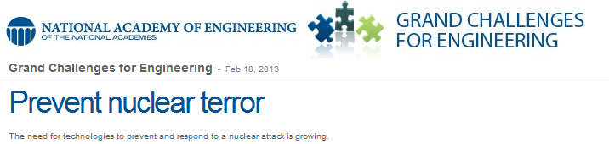
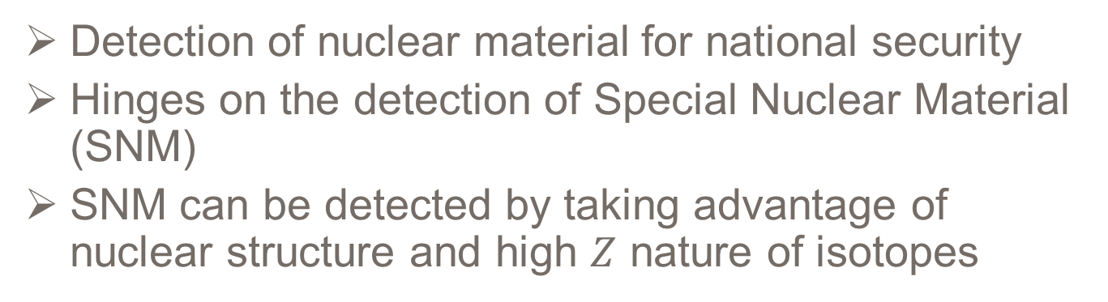
Article Motivation
Figure 1: NAE - Grand Challenges - “Prevent Nuclear Terror” Banner
Detection of nuclear material for national security
Hinges on the detection of Special Nuclear Material (SNM)
SNM can be detected by taking advantage of nuclear structure and high $Z$ nature of isotopes

Slide 5
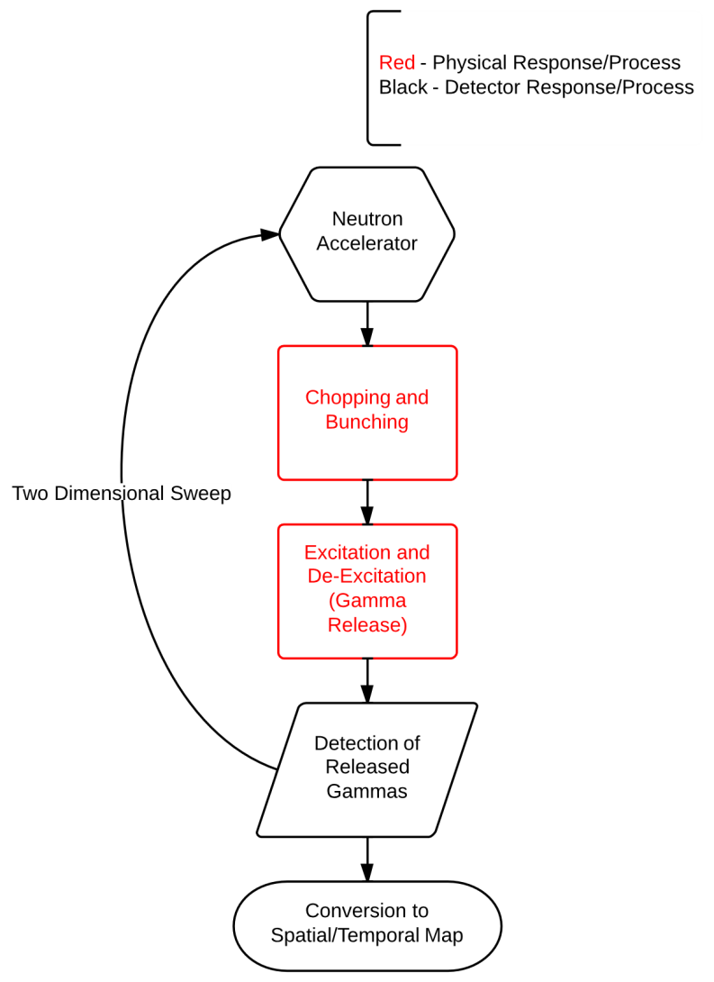
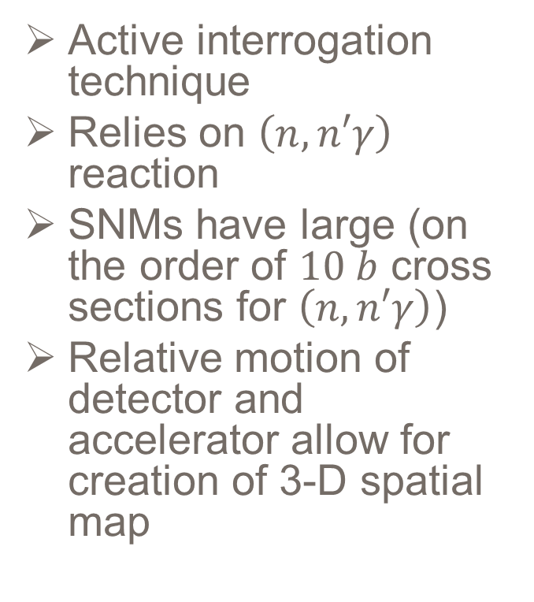
Pulsed Fast Neutron Analysis Technique Summary
Active interrogation technique
Relies on $\left(n,n′γ\right)$ reaction
SNMs have large (on the order of $10 b$ cross sections for $\left(n,n′γ\right)$)
Relative motion of detector and accelerator allow for creation of 3-D spatial map
Figure 2: PFNA Process Diagram

Slide 6
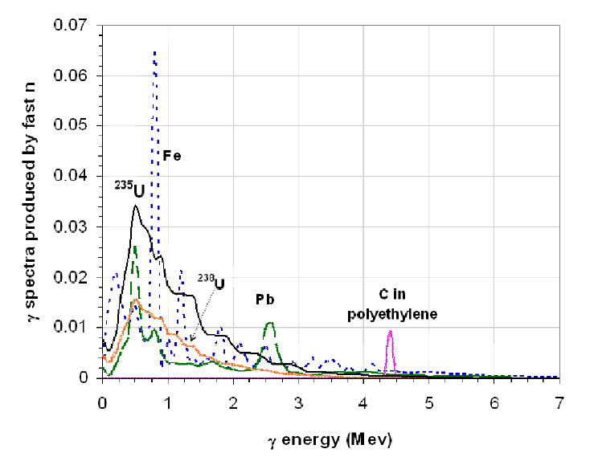
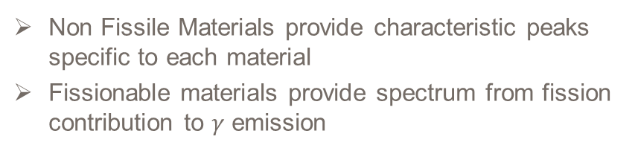
PFNA - Example Result
Non Fissile Materials provide characteristic peaks specific to each material
Fissionable materials provide spectrum from fission contribution to $γ$ emission
Figure 3: Simulated Gamma Spectra by Fast Neutrons [6]

Slide 7
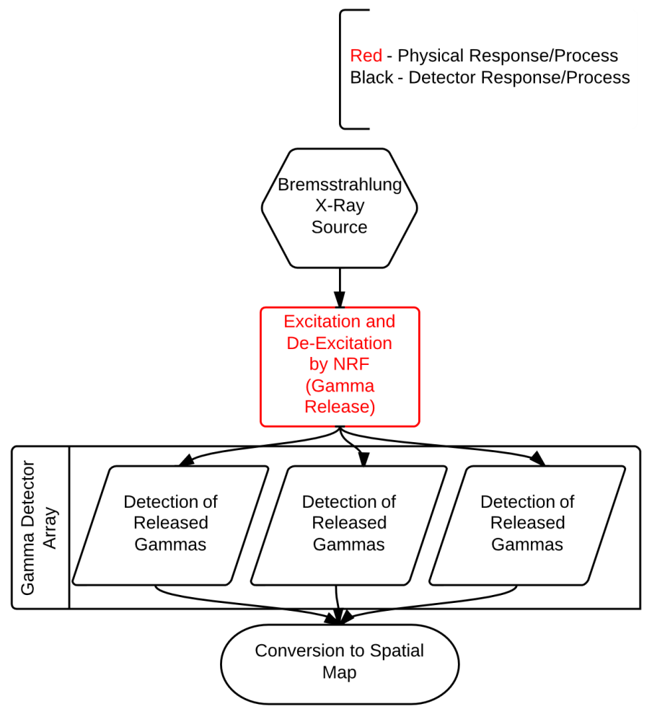
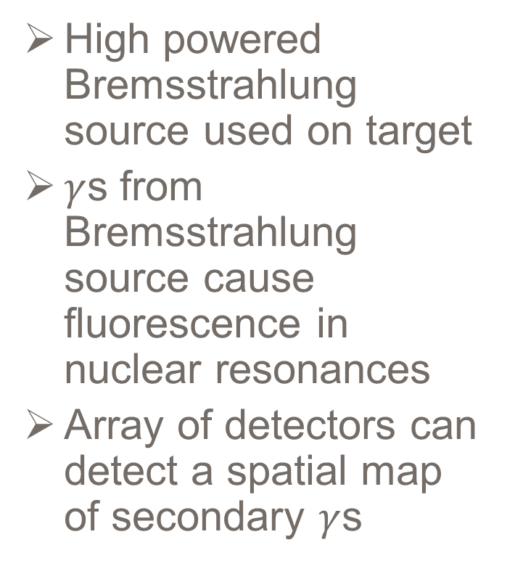
Nuclear Resonance Fluorescence Technique Summary
High powered Bremsstrahlung source used on target
$γ$s from Bremsstrahlung source cause fluorescence in nuclear resonances
Array of detectors can detect a spatial map of secondary $γ$s
Figure 4: NRF Process Diagram

Slide 8
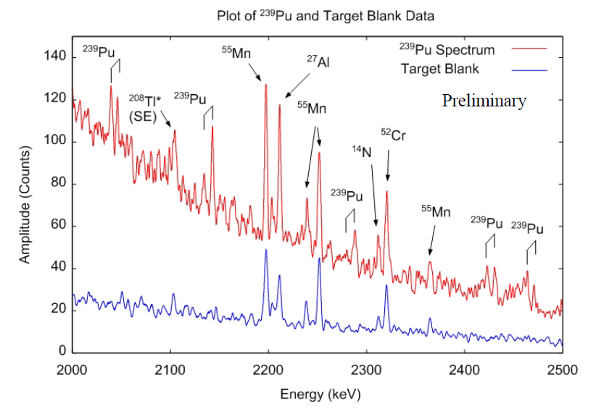
NRF Example Result
Provides spectra with peaks which are characteristic of isotopes present
Figure 4: NRF Spectrum of Pu and Target Blank in Energy Range of 2.0 to 2.5 MeV [1]

Slide 9
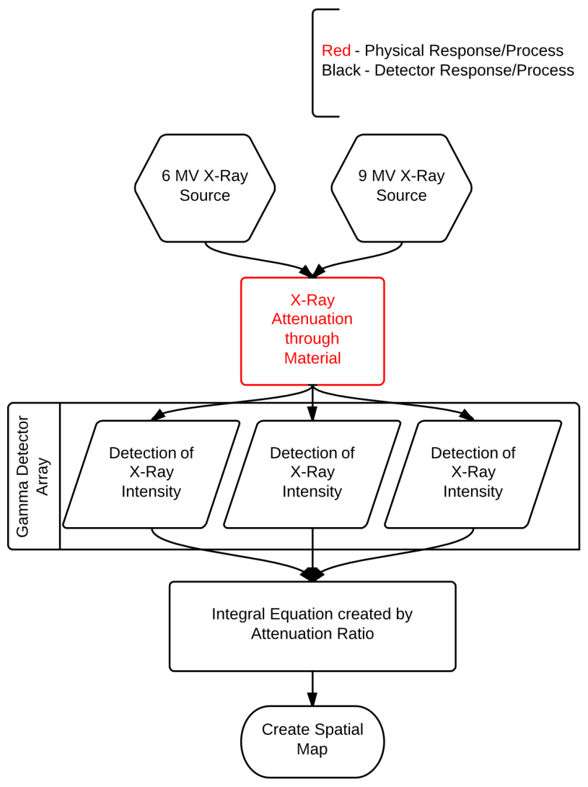
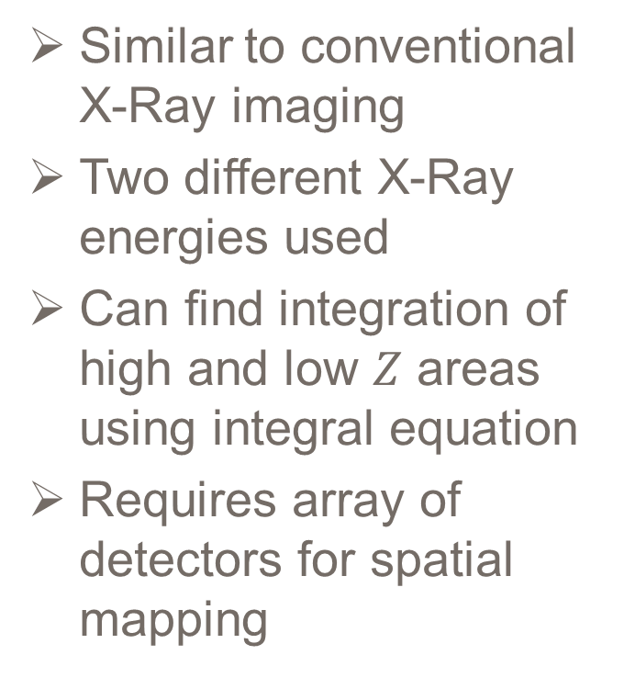
Dual Energy X-Ray Radiography Technique Summary
Similar to conventional X-Ray imaging
Two different X-Ray energies used
Can find integration of high and low $Z$ areas using integral equation
Requires array of detectors for spatial mapping
Figure 4: DEXR Process Diagram

Slide 10
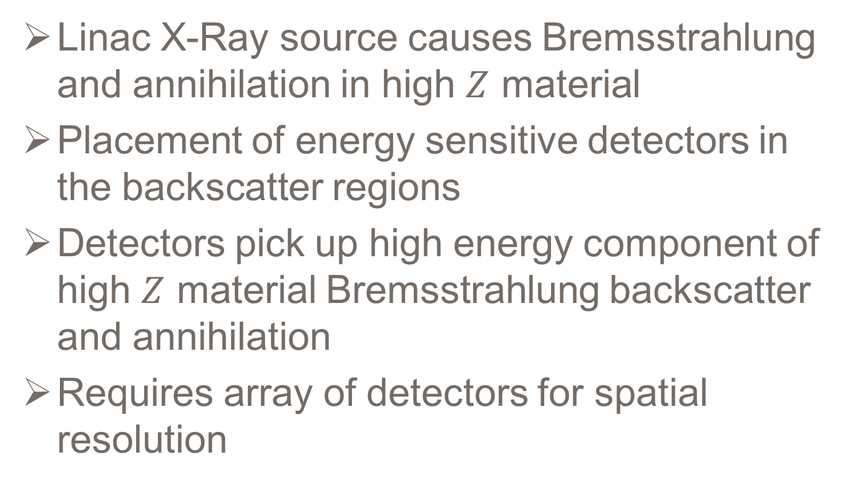
High Energy Bremsstrahlung Backscattering Technique Summary
Linac X-Ray source causes Bremsstrahlung and annihilation in high $Z$ material
Placement of energy sensitive detectors in the backscatter regions
Detectors pick up high energy component of high $Z$ material Bremsstrahlung backscatter and annihilation
Requires array of detectors for spatial resolution

Slide 11
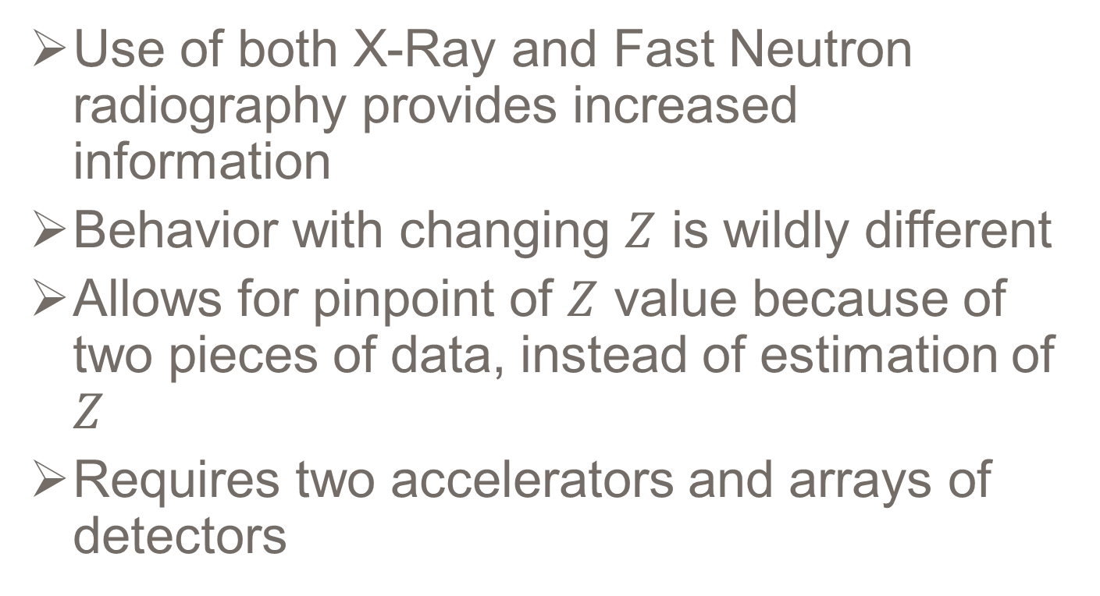
Dual Species Radiography Technique Summary
Use of both X-Ray and Fast Neutron radiography provides increased information
Behavior with changing $Z$ is wildly different
Allows for pinpoint of $Z$ value because of two pieces of data, instead of estimation of $Z$
Requires two accelerators and arrays of detectors

Slide 12
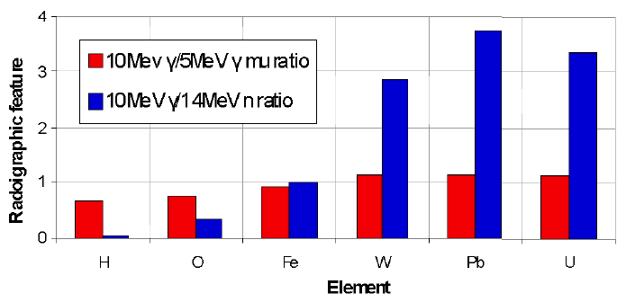
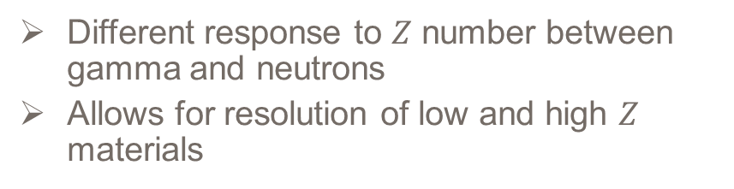
Dual Species Radiography
Different response to $Z$ number between gamma and neutrons
Allows for resolution of low and high $Z$ materials
Figure 5: Dual Species Radiography Ratio of Transmissions [5]

Slide 13
Article Critique
Discussion of citations, work presented, and target of Gozani’s paper

Slide 14
Motivation
NAE Grand Challenges show that the detection and interdiction of nuclear material has been identified as an important field
Gozani’s past work on explosives interdiction presents him as an expert on implementation, although relatively new in the field of radiation detection

Slide 15
Audience
Presented to the 2008 Conference on the Application of Accelerators in Research and Industry in “Technologies for Detecting Nuclear/Radiological Contraband” General Session
Other presentations in track give specific technology except one, which was chosen as review paper
Table 1: CAARI ‘08 Schedule of Events Excerpt
NHS02 | Title: Technologies for Detecting Nuclear/Radiological Contraband
R. Leon Feinstein | Active Interrogation Technologies for Nuclear Detection - Overview
Tsahi Gozani | Conventional and Non-conventional Nuclear Material Signatures
Steve Korbly | A Novel Electron Accelerator for Non-Intrusive Interrogation Applications
Christopher P.J. Barty | Tunable, Monochromatic X-rays in Interrogation - Production and Use
Donald P. Umstadter | Development of a source of quasi-monochromatic MeV energy photons for detection of special nuclear materials
Timothy Shaw | Fissile Material Detection by Differential Die Away Analysis

Slide 16
Citation Diversity
The paper’s main section describes work he completed in 1987 – 4 citations of his own work (1,2,3,7)
The paper provides too few citations on other methods
NRF – 2 citations (4,5)
DEXR – 1 citation (6)
HEBB – no citations

Slide 17
High Energy Bremsstrahlung Backscattering
No citations for origin for experimental status of technology
Provides experimental results without sufficient methods for reproduction
Makes claims without published results
“In addition the size of the detector collimation determines the degree of debasing…”
“…modeled with photon/electron Monte Carlo transport codes… …and reliably measured.”

Slide 18
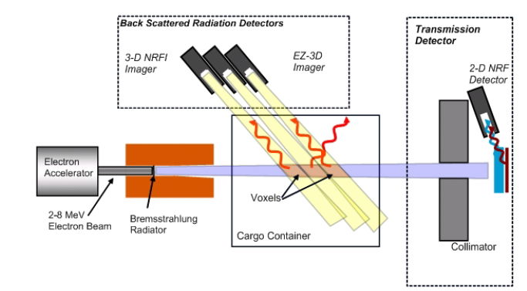
HEBB Literature Provided
Gozani does not cite any source for HEBB
Uses the small overview from Bertozzi’s paper
HEBB used in American Science and Engineering’s Z Portal technology
Figure 6: High Energy Bremsstrahlung Backscattering Idea Diagram [1]

Slide 19
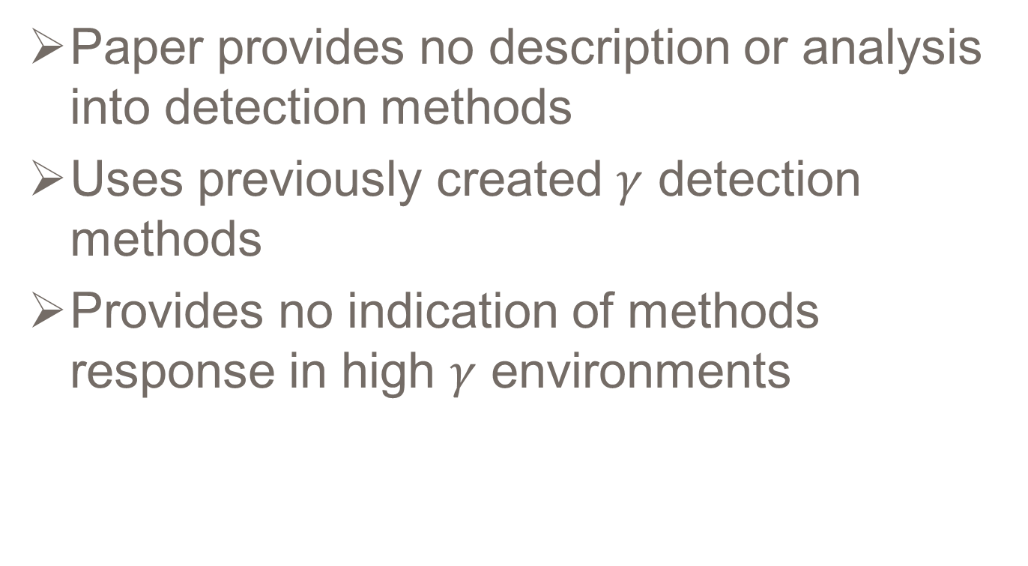
Detection Modes
Paper provides no description or analysis into detection methods
Uses previously created $γ$ detection methods
Provides no indication of methods response in high $γ$ environments

Slide 20
Article Critique - Overall
Well placed to impact field
Provided an overview paper into the area “Technologies for Detecting Nuclear/Radiological Contraband”
Described one unverified technique
Did not describe detector physics for any methods
Provided very little implementation instructions for any technique

Slide 21
Article Extension
Proposal of additions or changes to article

Slide 22
Extension Proposals
More technical basis
More implementation based descriptions
Cost
Efficiency
Resolution
Implementation
Direct comparison between methods
Modeling of methods for insight into efficiency and applications

Slide 23
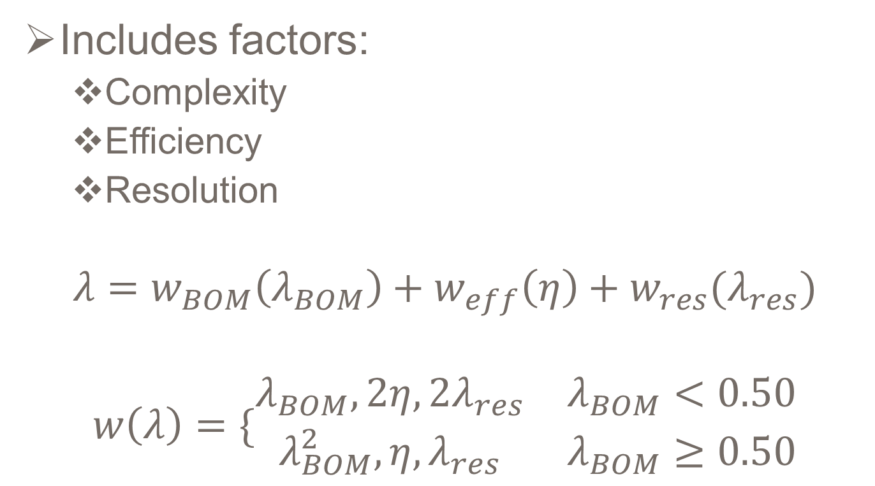
Chosen Extension Proposal: Methods Comparison
Includes factors:
Complexity
Efficiency
Resolution
$$λ=w_{BOM}\left(λ_{BOM}\right)+w_{eff}\left(η\right)+w_{res}(λ_{res})$$
$$w\left(λ\right)=\{\begin{matrix}λ_{BOM},2η,2λ_{res} & λ_{BOM}<0.50 \\ λ_{BOM}^{2},η,λ_{res} & λ_{BOM}≥0.50\end{matrix}$$

Slide 24
Complexity
Complex designs have distinct disadvantages
Increased modes of failure
Increased cost
Increased difficulty of use
Increased difficulty of implementation
Current measure of complexity is only Bill of Materials parts count, could be changed to describe the complexity of each part in respect to cost, rate of failure, and difficulty of use

Slide 25
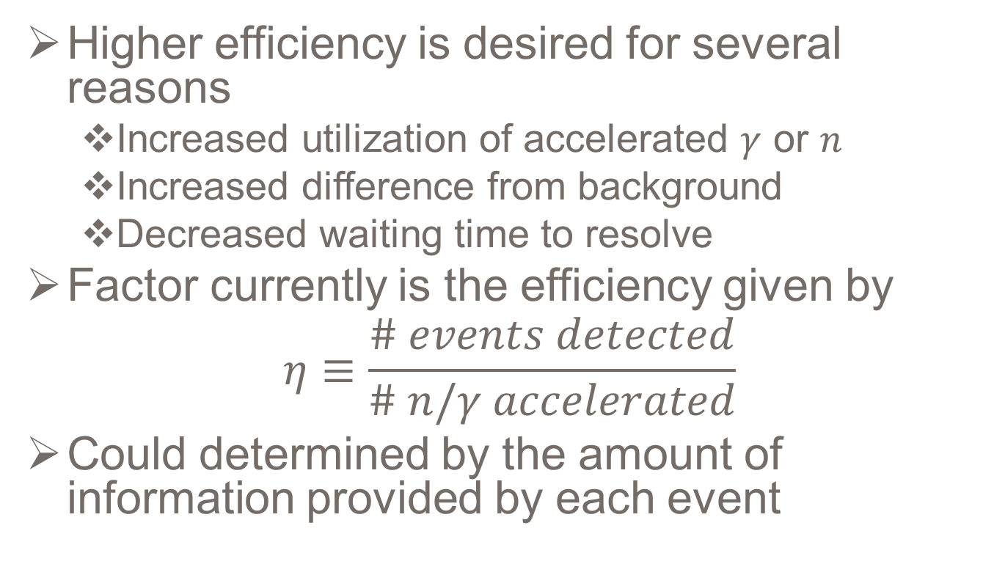
Efficiency
Higher efficiency is desired for several reasons
Increased utilization of accelerated $γ$ or $n$
Increased difference from background
Decreased waiting time to resolve
Factor currently is the efficiency given by
$$η≡\frac{\# events detected}{\# n/γ accelerated}$$
Could determined by the amount of information provided by each event

Slide 26
Resolution
Increased resolution is crucial to interdicting nuclear material in a timely manner
High resolution will decrease search time and help to increase customs clearance speed
Current factor is the resolution compared to the state of the art resolution

Slide 27
Article Extension Summary
Creation of weighting scheme and identification of key factors
MCNP modeling, more sophisticated mathematical weighting, and close look into price and implementation of systems is required

Slide 28
References
[1] W Berttozi. Detecting Special Nuclear Materials and Explosives Using Nuclear Resonance Fluorescence and Eective-Z Technology. In 8th International TOpical Meeting on Nuclear Applications and Utilization of Accelerators (ACCAPP07), Pocatello, Idaho, 2007. American Nuclear Society.
[2] Inc. Canberra Industries. Germanium Detectors. Technical report, Canberra Industries, Inc., Meriden, CT, 2008.
[3] G Chen. Dual Energy X-Ray Radiography for Automatic High Z Material Detection. Nuclear Instruments and Methods in Physics Research B, 261:356359, 2007.
[4] Tsahi Gozani. Understanding the Physics Limitations of PFNA - The Nanosecond Pulsed Fast Neutron Analysis. Nuclear Instruments and Methods in Physics Research, 99(March 1991):743747, 1995.
[5] Tsahi Gozani. Fission Signatures for Nuclear Material Detection. IEEE Transactions on Nuclear Science, 56(3):736741, June 2009.
[6] Tsahi Gozani, Floyd D. McDaniel, and Barney L. Doyle. Conventional and Non-Conventional Nuclear Material Signatures. AIP Conference Proceedings, 599(1):599605, 2009.
[7] IAEA. Against the Spread of Nuclear Weapons - Limits to the Safeguards System, 2010.
[8] Kyoshiro Imagawa. NaI Scintillation Detector. Technical report, Horiba, Ltd., Kyoto, Japan, 2004.
[9] Micah S Johnson, Dennis P Mcnabb, and B Eric. Final Task Report on NRF Measurements of Photon Scattering Resonances in Plutonium at the High Voltage Research Laboratory of MIT. 2007.
[10] G F Knoll. Radiation Detection and Measurement. John Wiley & Sons, Inc., Ann Arbor, MI, third edition, 2000.
[11] R T Kouzes, J H Ely, L E Erikson, W J Kernan, A T Lintereur, E R Siciliano, D C Stromswold, and M L Woodring. Alternative Neutron Detection Testing Summary. Technical report, Pacic Northwest National Laboratory, Richland, WA, 2010.
[12] B J Micklich, C L Fink, and L Sagalovsky. Transport Simulation and Image Reconstruction for Fast-Neutron Detection of Explosives and Narcotics. Technical report, Argonne National Laboratory, Chicago, IL, 1995.
[13] National Academy of Engineering. Grand Challenges - Engineering Challenges, 2012.
[14] J Rynes, J Bendahan, T Gozani, R Loveman, J Stevenson, and C Bell. Gamma-ray and neutron radiography as part of a pulsed fast neutron analysis inspection system. Nuclear Instruments and Methods in Physics Research Section A: Accelerators, Spectrometers, Detectors and Associated Equipment, 422(1-3):895899, February 1999.
[15] Z P Sawa and T Gozani. PFNA Technique for the Detection of Explosives. In S M Khan, editor, Proceedings of the First International Symposium on Explosive Detection Technology, pages 82103, 1991.
[16] Toshiyuki Shizuma, Takehito Hayakawa, Ryoichi Hajima, Nobuhiro Kikuzawa, Hideaki Ohgaki, and Hiroyuki Toyokawa. Nondestructive identication of isotopes using nuclear resonance uorescence. The Review of scientic instruments, 83(1):015103, January 2012.
[17] J Stevenson. SNM & Other High-Z Material Identication Using Pulsed Fast Neutron Analysis, 2006.

Slide 29
Questions

Slide 30
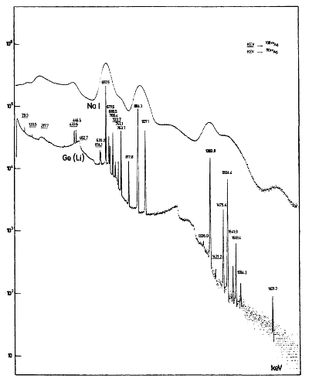
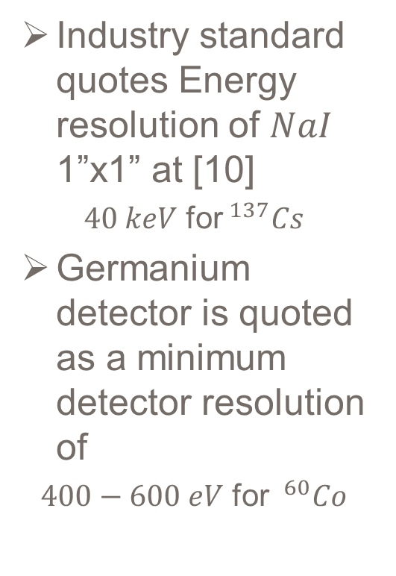
Detector Resolution
Industry standard quotes Energy resolution of $NaI$ 1”x1” at [10]
$40 keV$ for$^{137}Cs$
Germanium detector is quoted as a minimum detector resolution of
$400−600 eV$ for $^{60}Co$
Figure A1: Comparative Spectra between NaI and Ge [10]

Slide 31
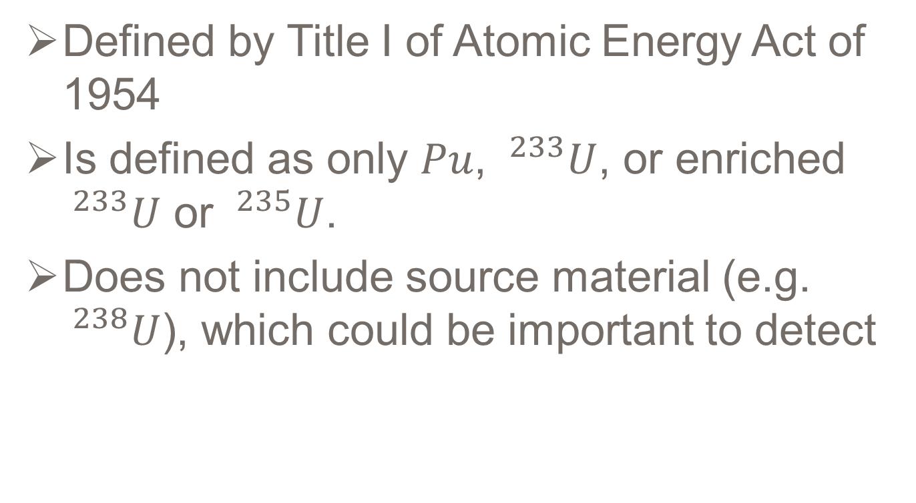
Special Nuclear Material (SNM)
Defined by Title I of Atomic Energy Act of 1954
Is defined as only $Pu$, $^{233}U$, or enriched $^{233}U$ or $^{235}U$.
Does not include source material (e.g. $^{238}U$), which could be important to detect

